Slide 1

ShopKart Automation: Selenide, REST Assured, and Allure Reporting
Modern tools enhancing automated testing and reporting efficiency
Notes:
AI-generated content may be incorrect. ---

Slide 2
Introduction and Context
Notes:
ShopKart Automation Framework Overview

Slide 3
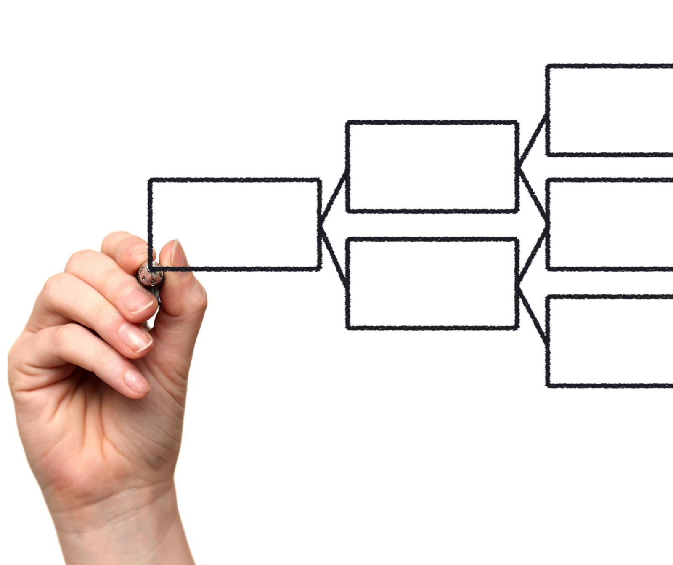
ShopKart Automation Framework Overview
UI and API Testing Technologies
The framework integrates Selenide for UI testing and REST Assured for validating backend REST APIs.
Maintainability with Page Object Model
Maintainability is ensured by applying the Page Object Model design pattern for clear test structure.
Reliability and Synchronization
Explicit synchronization strategies are used to enhance test reliability and reduce flaky results.
Visibility through Rich Reporting
Rich Allure reporting provides comprehensive visibility into test execution and results.
Notes:
This presentation provides a comprehensive overview of the ShopKart automation framework built using a combination of UI and API testing technologies. The goal of the framework is to validate end-to-end business flows through the web interface using Selenide, as well as core backend functionality through REST APIs using REST Assured. A strong emphasis is placed on maintainability through the Page Object Model, reliability through explicit synchronization strategies, and visibility through rich Allure reporting. The framework is designed not only to validate correctness but also to serve as a reference-quality automation implementation that demonstrates best practices in modern test engineering. Over the course of this session, we walk through the key problems encountered, how they were diagnosed, and how they were resolved in a production-grade manner.

Slide 4
Technology Stack
Notes:
Core Tools and Libraries

Slide 5

Core Tools and Libraries
Programming and Build Tools
The framework is developed using Java 22 and managed with Gradle, ensuring efficient build automation and dependency management.
Testing Frameworks
JUnit 5 executes tests with modern features, while Selenide simplifies browser automation on Selenium WebDriver.
API Testing and Reporting
REST Assured enables expressive API validation, and Allure generates detailed reports with execution steps and trends.
Continuous Integration and Publishing
GitHub Actions automates CI pipelines, while GitHub Pages hosts Allure reports for stakeholder access.
Notes:
The ShopKart automation framework is built on Java 22 and managed using Gradle as the build tool. JUnit 5 is used as the test execution engine, providing modern annotations, lifecycle hooks, and integration with both UI and API tests. Selenide is used for browser-based automation on top of Selenium WebDriver, offering concise syntax and built-in waits. REST Assured is integrated for API testing, enabling expressive validation of HTTP requests and responses. Allure is used as the reporting solution to capture execution results, steps, attachments, and trends. GitHub Actions orchestrates continuous integration, while GitHub Pages is used to publish the generated Allure reports for easy stakeholder access.

Slide 6
UI Automation with Selenide
Notes:
End-to-End UI Workflow, Page Object Model Design

Slide 7
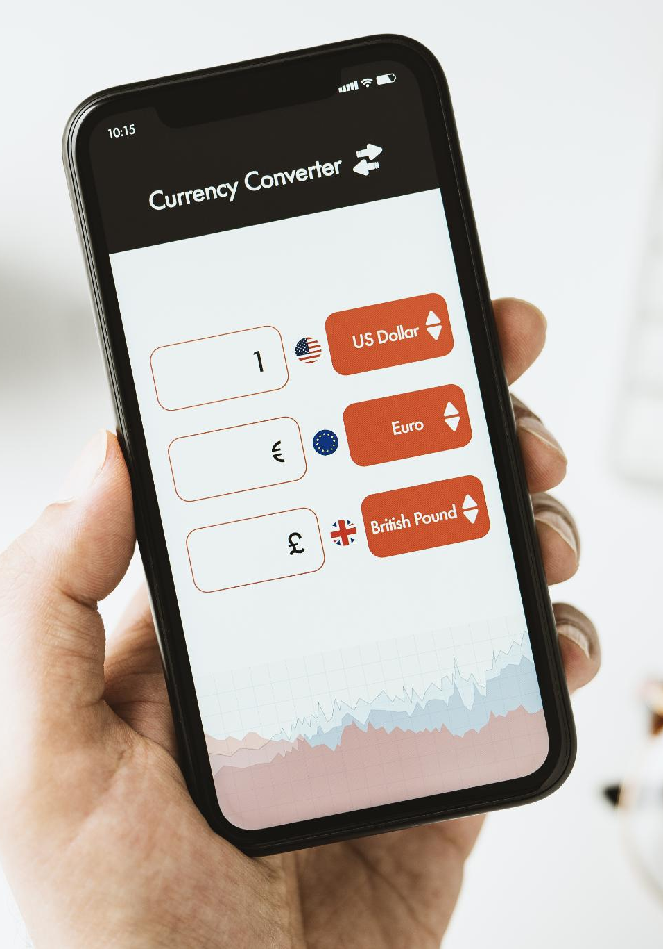
End-to-End UI Workflow
Primary User Journey
Automation covers login, product search, cart management, checkout, and order placement mimicking real user behavior.
Automation with Selenide
Selenide framework ensures readable, stable tests resilient to asynchronous UI updates.
Assertions and Validation
Meaningful assertions verify the application state aligns with business expectations at each flow stage.
Notes:
The UI automation layer validates the primary ShopKart user journey through the browser. This includes logging in with valid credentials, searching for a product, adding the product to the cart, reviewing the cart contents, proceeding to checkout, entering shipping details, and finally placing an order. Each of these steps is automated using Selenide with a focus on readability and stability. The tests are written to reflect real user behavior and are resilient to asynchronous UI updates. Assertions are placed at meaningful checkpoints to ensure the application state aligns with business expectations at each stage of the flow.

Slide 8
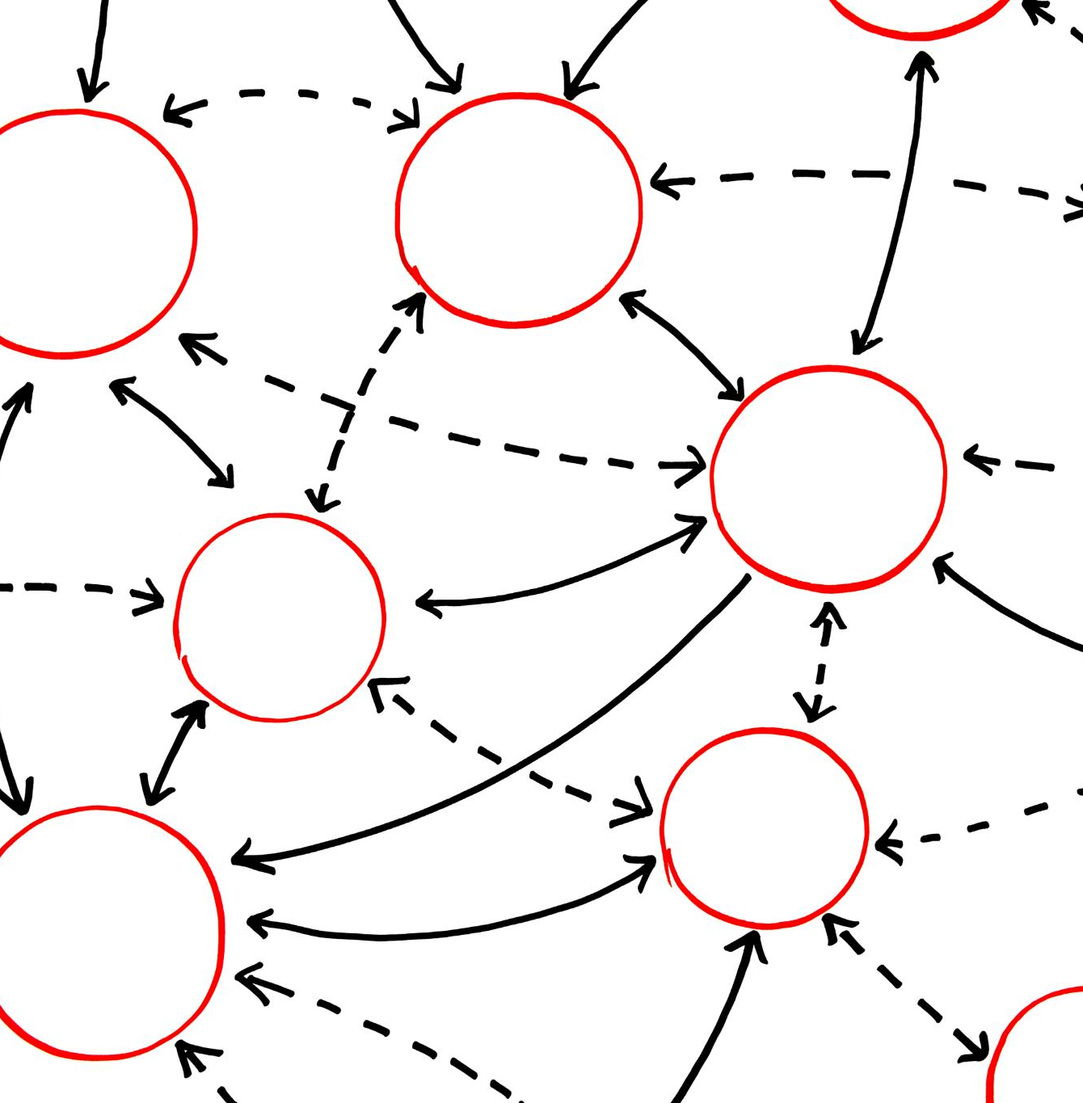
Page Object Model Design
Page Object Model Structure
The framework uses page classes to encapsulate UI locators and interactions for modular design.
Test Interaction Abstraction
Tests interact only with page-level abstractions, avoiding direct selector usage to improve clarity.
Centralized Verification Methods
Verification methods in page classes centralize assertions, ensuring clear workflow and behavior separation.
Notes:
To ensure maintainability and clarity, the framework adopts the Page Object Model. Separate page classes such as LoginPage, CatalogPage, CartPage, CheckoutPage, and OrdersPage encapsulate UI locators and interactions. Tests interact only with these page-level abstractions rather than directly with selectors. This approach reduces duplication, improves readability, and isolates changes when the UI evolves. Verification methods such as verifyLoaded or verifyOrderConfirmed centralize assertions within page classes, reinforcing the principle that tests describe workflows while pages describe behavior.

Slide 9
Synchronization Challenges and Solutions
Notes:
Asynchronous Cart Loading Issue, Robust Synchronization Strategy

Slide 10
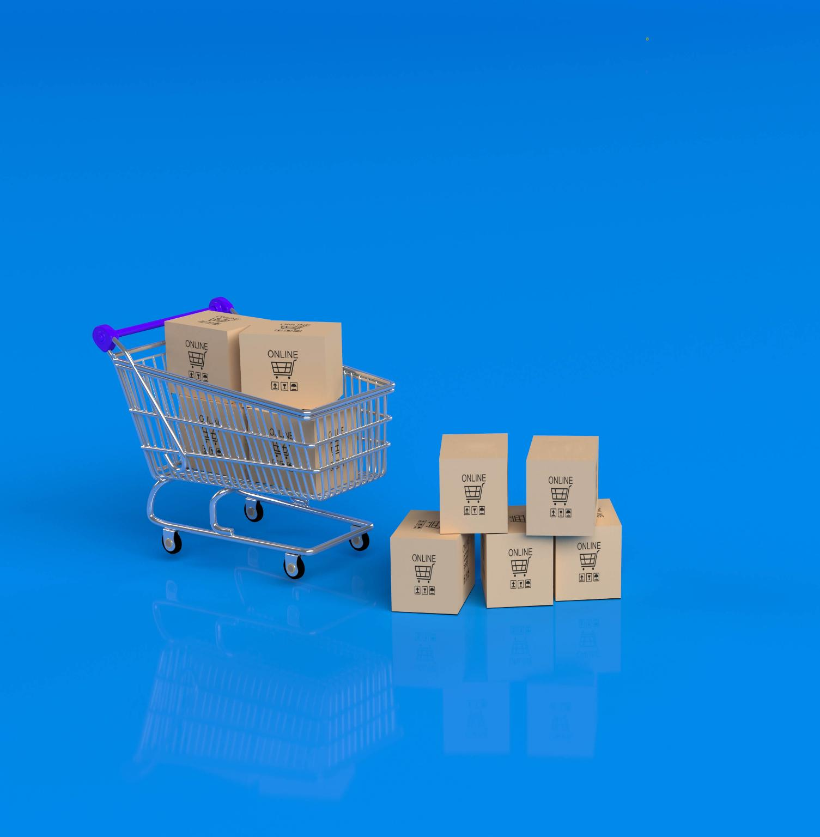
Asynchronous Cart Loading Issue
Asynchronous Loading Behavior
The cart page initially shows an empty state before loading item rows asynchronously after product addition.
Early Verification Flaw
Checking only page headings caused tests to proceed before cart data was fully loaded, causing test flakiness.
Synchronization on Business Data
Synchronizing tests on actual cart data rather than static elements is critical to avoid flaky failures during checkout.
Notes:
A key challenge encountered during UI automation was the asynchronous loading behavior of the Cart page. When the cart was opened immediately after adding a product, it initially displayed an empty state before later populating with item rows. Early implementations verified only the presence of the page heading, which caused tests to advance before the cart data was fully loaded. This resulted in flaky failures downstream, particularly during checkout. The issue highlighted the importance of synchronizing on business data rather than static page elements.

Slide 11

Robust Synchronization Strategy
Explicit Waiting Using Conditions
Waiting explicitly for UI elements like cart item rows using conditions improves test stability and accuracy.
Avoiding Arbitrary Delays
Synchronizing on actual UI data prevents unreliable waits like Thread.sleep and arbitrary delays in tests.
Consistent Synchronization Pattern
Applying this synchronization approach consistently across catalog, cart, and checkout ensures deterministic test outcomes.
Best Practice for Async UIs
This strategy exemplifies best practices for handling asynchronous user interfaces in automated testing frameworks.
Notes:
The solution involved waiting explicitly for cart item rows to be present using Selenide collection conditions such as sizeGreaterThan(0). By synchronizing on the actual data that signifies a loaded cart, the tests became stable and deterministic without relying on Thread.sleep or arbitrary delays. This pattern was applied consistently across the framework: waiting for product cards to appear in the catalog, cart rows to load in the cart, and form fields to become visible on the checkout page. This approach represents a best practice for handling asynchronous UIs in automated tests.

Slide 12
API Automation with REST Assured
Notes:
Authentication API Test, Product Search API Test

Slide 13

Authentication API Test
REST Assured Authentication Test
Validates the authentication endpoint by sending a POST request with user credentials in JSON format.
Response Validation
Ensures successful HTTP status and valid authentication token with correct customer details in the response.
Backend Authentication Verification
Confirms backend authentication works independently of UI and supports authenticated API workflows.
Notes:
The first REST Assured test validates the authentication endpoint used by the ShopKart application. A POST request is sent to the login API with user credentials in JSON format. The response is validated to ensure a successful HTTP status code is returned, along with a non-null authentication token and correct customer details such as ID, persona, email, and display name. This test verifies that backend authentication works independently of the UI and can be used as a foundation for authenticated API workflows.

Slide 14

Product Search API Test
API Request and Parameterization
The test sends a parameterized GET request to the product search API endpoint with a specific product keyword.
JSON Array Response Validation
The response is validated as a JSON array containing products matching the query with expected item counts.
Attribute Assertions
Assertions check product attributes like SKU, name, category, price, stock, and image key for accuracy.
UI and Backend Data Alignment
The test verifies that backend API data corresponds correctly with the UI-visible product information.
Notes:
Another REST Assured test focuses on product search functionality. A GET request is sent to the products endpoint with a query parameter specifying a product keyword. The response is expected to be a JSON array containing matching products. Assertions validate that the array contains the expected number of items and that each item’s attributes such as SKU, name, category, price, stock, and image key match expected values. This test demonstrates parameterized requests, JSON array validation, and alignment between UI-visible data and backend responses.

Slide 15
Allure Reporting
Notes:
Allure Results and Report Generation

Slide 16
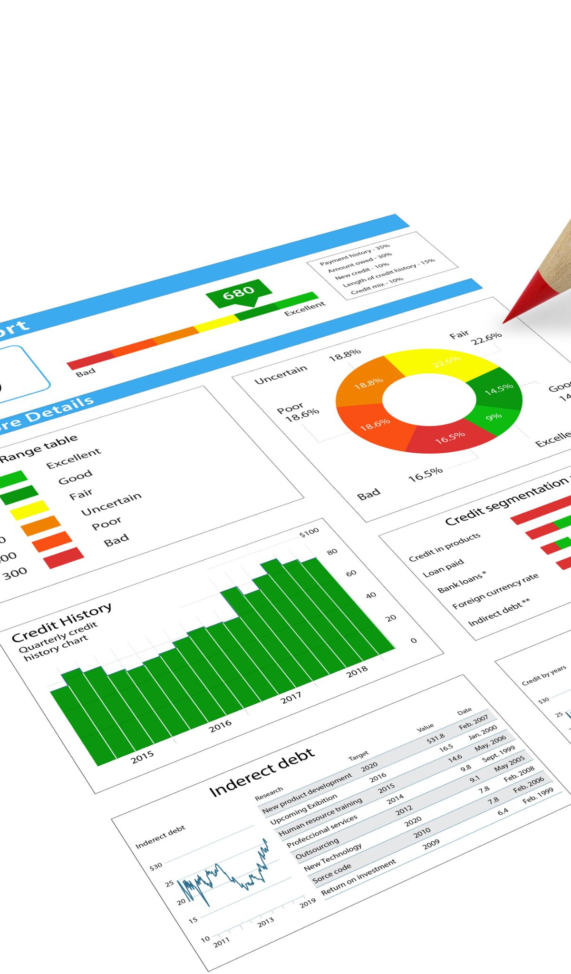
Allure Results and Report Generation
Test Result Generation
Tests produce JSON files capturing statuses, steps, error traces, and metadata during execution.
Interactive HTML Reports
JSON results are converted into interactive HTML reports for detailed analysis and visualization.
Multiple Perspectives in Reporting
Reports provide views like Overview, Suites, Behaviors, and History to reveal quality trends over time.
Failure Diagnosis Features
Attachments and step details in reports help engineers quickly identify and diagnose test failures.
Notes:
Allure is used to provide rich, actionable reporting for both UI and API tests. During execution, tests generate JSON result files in the allure-results directory, capturing statuses, steps, error traces, and metadata. These results are later transformed into an interactive HTML report. The report provides multiple perspectives such as Overview, Suites, Behaviors, and History, allowing engineers and stakeholders to understand quality trends over time. Attachments and steps make failures easy to diagnose.

Slide 17
CI/CD and Publishing Strategy
Notes:
GitHub Actions and GitHub Pages

Slide 18

GitHub Actions and GitHub Pages
Local Test Execution
Tests are executed locally and the allure-results are committed to the repository for further processing.
Automated Report Generation
GitHub Actions workflow generates Allure reports automatically from committed test results.
Deployment via GitHub Pages
Generated reports are deployed to the gh-pages branch enabling easy web access for repository users.
Historical Report Preservation
Historical test reports are preserved for trend analysis and long-term monitoring of execution results.
Notes:
The automation framework integrates with GitHub Actions to publish Allure reports automatically. In this setup, tests are run locally, and the generated allure-results are committed or copied into the repository. A simplified GitHub Actions workflow then generates the Allure report from these results and deploys it to the gh-pages branch using GitHub Pages. This allows anyone with repository access to view execution reports without installing Allure locally. Historical reports are preserved, enabling trend analysis.

Slide 19
Live Report and Repository
Notes:
Accessing the ShopKart Allure Report

Slide 20

Accessing the ShopKart Allure Report
Automation Framework Overview
The framework includes UI and API tests along with reporting configurations hosted publicly on GitHub at the url georgebibu-UST/shopkart_automation in the pages section, the report is hosted live using GitHub Pages.
Allure Report Access
Allure reports are published via GitHub Pages showing real execution results, categories, and test history.
Use Cases of Report
The report acts as a single source of truth for demos, reviews, and audits by showcasing test outcomes clearly.
Notes:
The complete automation framework, including UI tests, API tests, and reporting configuration, is available in the public GitHub repository. Users can also access the published Allure report hosted via GitHub Pages, which demonstrates real execution results, categories, and history. This publicly accessible report serves as a single source of truth for test execution outcomes and is ideal for demos, reviews, and audits.

Slide 21
Key Learnings and Conclusion
Notes:
Lessons Learned and Best Practices

Slide 22

Lessons Learned and Best Practices
Effective Synchronization
Robust synchronization using business conditions improves test reliability over static delays.
Page Object Model Design
Using Page Object Model leads to cleaner, maintainable and scalable automated tests.
Combined UI and API Testing
Combining UI and API tests delivers broader coverage and faster feedback cycles.
Enhanced Reporting Integration
Integrating Allure reports with CI and GitHub Pages improves test result visibility and accessibility.
Notes:
This project reinforced several important testing principles. Robust synchronization based on business conditions is superior to static delays. Page Object Model design leads to cleaner, more maintainable tests. Combining UI and API tests provides broader coverage and faster feedback. Finally, integrating Allure reporting with CI and GitHub Pages dramatically improves visibility and accessibility of test results. Together, these practices form a solid foundation for scalable, production-ready automation frameworks.

